Slide 1
Use of High Throughput Assays and Predictive Models in the U.S. EPA Endocrine Disruptor Screening Program
David Dix, Ph.D.
Director, Office of Science Coordination and Policy
Office of Chemical Safety and Pollution Prevention
U.S. Environmental Protection Agency
FutureTox III: Contemporary Concepts in Toxicology (CCT) Conference
Friday, November 20th, 2015
Arlington, VA

Slide 2
Endocrine Disruptor Screening Program (EDSP)
Established in 1998
Protection of human health and wildlife
Includes estrogen, androgen and thyroid pathways
Approach
  Prioritization based on exposure and endocrine bioactivity
  Screening for bioactivity
  Testing for dose-response and adverse effects
More chemicals
Fewer chemicals
Prioritization
Bioactivity/ Exposure
Screening
Bioactivity
Testing
Adversity/Dose-Response

Slide 3
Screening for Bioactivity: EDSP Tier 1
Tier 1 Screening Battery | Endocrine Pathway
 | E + | E - | A + | A - | HPG Axis | HPT Axis
In vitro
ER Binding | X | X
ERα Transcriptional Activation* | X
AR Binding |  |  | X | X
Steroidogenesis H295R* | X | X | X | X
Aromatase Recombinant |  | X
In vivo
Uterotrophic* | X
Hershberger* |  |  | X | X
Pubertal Male | X | X | X | X | X | X
Pubertal Female | X | X | X | X | X | X
Amphibian Metamorphosis* |  |  |  |  |  | X
Fish Short-Term Reproduction (male & female)* | X | X | X | X | X
*OECD Harmonized

Slide 4
Testing for Adversity and Dose-Response: EDSP Tier 2
Mammalian
Mammalian Two-Generation Reproduction (Rat)
Extended One Generation Reproduction Test (Rat)
Ecological
Japanese Quail Toxicity Test
Larval Amphibian Growth and Development Assay (Xenopus laevis)
Medaka Extended One Generation Reproduction Test

Slide 5
Evolution of EDSP
EDSP Chemical Universe
10,000 chemicals
(FIFRA & SDWA)
EDSP List 2
107 Chemicals
CompTox 3,000 Chemicals
EDSP List 1
67 Chemicals
Based on current pace it could take decades to screen all 10,000 chemicals in EDSP Universe
Employ high throughput assays and predicitve models to rapidly screen chemicals for potential bioactivity and exposure

Slide 6
EDSP Prioritization, Screening & Testing
Prioritization
Bioactivity/Exposure
Screening
Bioactivity
Testing
Dose-Response/Adversity
More chemicals
Fewer chemicals
Relies on:
QSARs
ToxCast/ExpoCast
Monitoring data
OSRI
Relies on:
QSARs
ToxCast
EDSP Tier 1 data
OSRI
Relies on:
EDSP Tier 2 data
OSRI
  Prioritization and Screening for bioactivity
  Testing for dose-response and adverse effects
Slide 6 of 18

Slide 7
Scientific Confidence: Current Methods
How do HTS results compare with ER-mediated response in validated Tier 1 assays?
Tier 1 Battery ER-specific endpoints
Tier 1 Screening Battery | Endocrine Pathway
 | E + | E - | A + | A - | HPG Axis | HPT Axis
In vitro
ER Binding | X | X
ERα Transcriptional Activation* | X
In vivo
Uterotrophic* | X
Pubertal Female | X | X |  |  | X | X
Fish Short-term Reproduction (male & female)* | X | X | X | X | X
https://www.federalregister.gov/articles/2015/06/19/2015-15182/use-of-high-throughput-assays-and-computational-tools-endocrine-disruptor-screening-program-notice
*
Slide 7 of 18

Slide 8
High Throughput Assays Integrated Into an ER Predictive Pathway Model
Judson et al. 2015. “Integrated Model of Chemical Perturbations of a Biological Pathway Using 18 In Vitro High Throughput Screening Assays for the Estrogen Receptor” Toxicological Sciences.
Slide 8 of 18

Slide 9
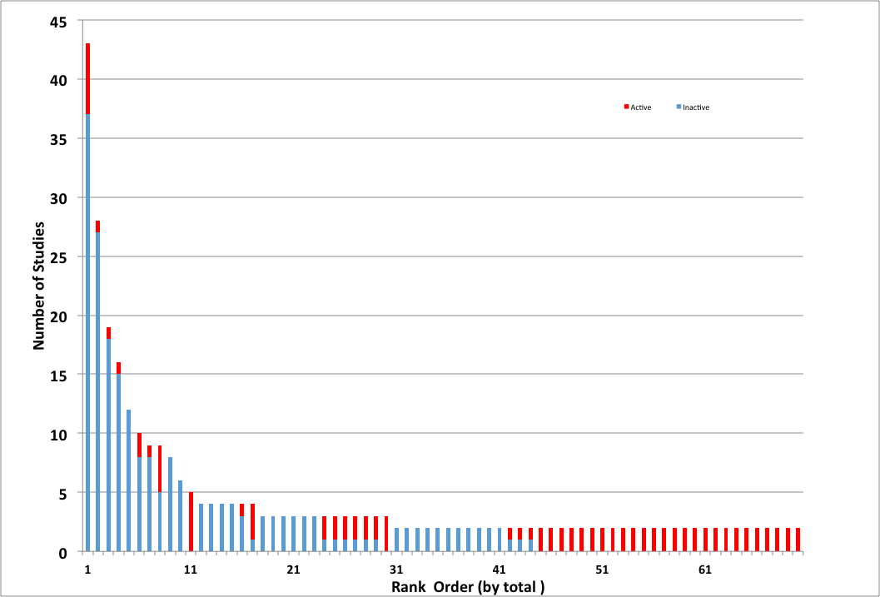
ER Bioactivity Model Versus EDSP Tier 1
ER model performs as well or better than existing methods
Model evaluated with 45 reference chemicals
  T1 ER binding: 23 (35% were not were not consistent with expected outcome)
  T1 ERTA: 12
  T1 UT: 7
ER model in 100% agreement with Tier 1 ER, ERTA, and Uterotrophic results for List 1 chemicals (very low or no ER activity)
ER model may be more sensitive than Tier 1 assays due to redundancy
Results from uterotrophic studies for chemicals that had at least two independent GL studies. Blue bars represent the number of active reports; red bars represent the number of inactive reports. Data from chemicals commonly used as positive controls (i.e., ethinyl estradiol and estradiol) were excluded from this plot.
Inactive Active
[Kleinstreuer et al. 2015 Environmental Health Perspectives]
Slide 9 of 18

Slide 10
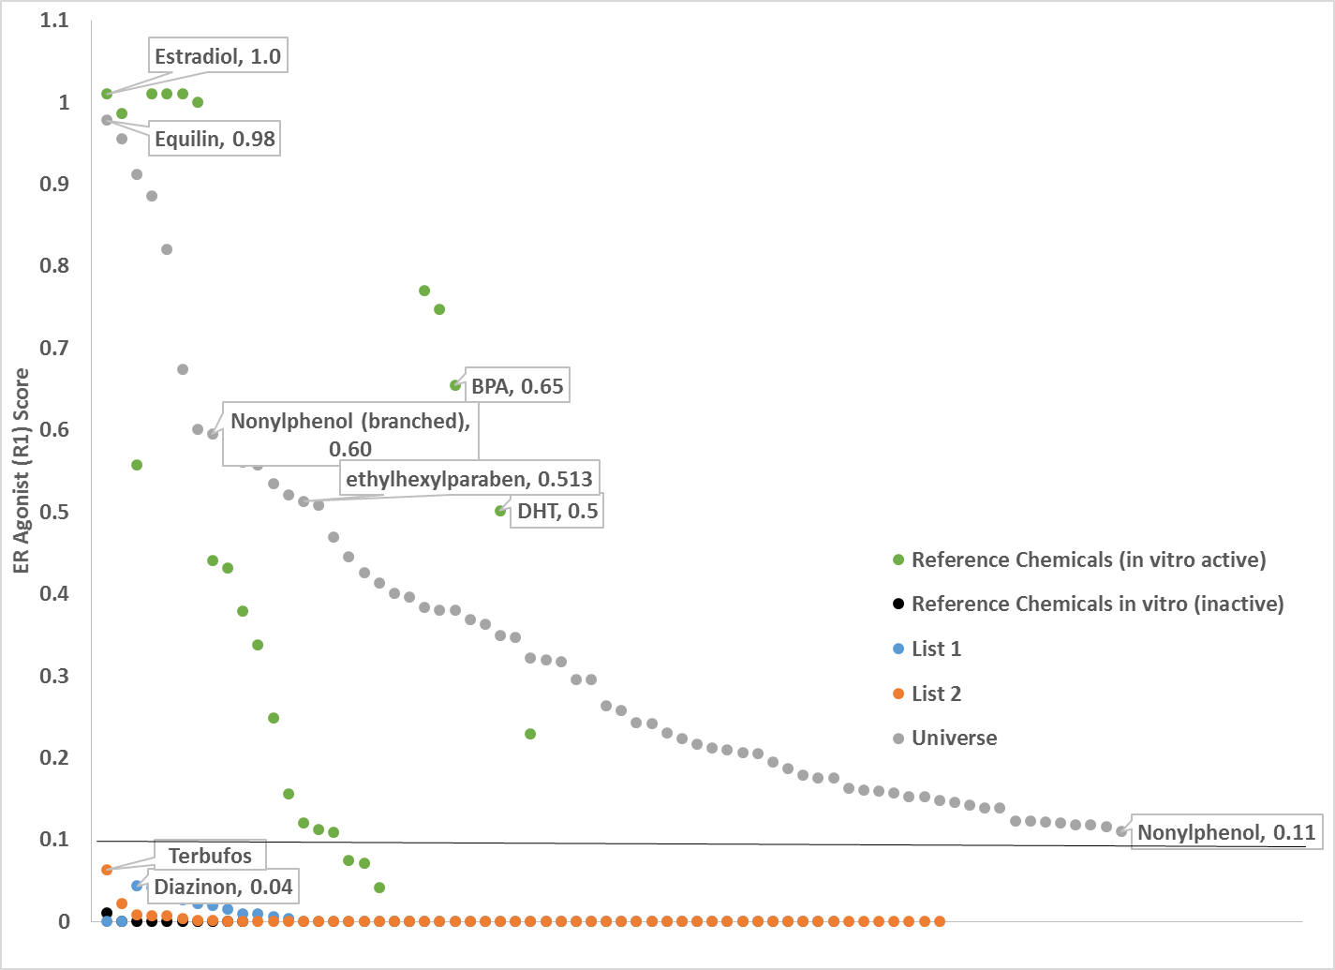
ER Agonist Bioactivity
Browne et al. 2015
Slide 10 of 18

Slide 11

EDSP “Pivot” Announcement
June 19, 2015
FRL-9928-69
“Use of High Throughput Assays
and Computational Tools;
Endocrine Disruptor
Screening Program;
Notice of Availability and
Opportunity for Comment”
https://www.federalregister.gov/articles/2015/06/19/2015-15182/use-of-high-throughput-assays-and-computational-tools-endocrine-disruptor-screening-program-notice
Slide 11 of 18

Slide 12
Evolution of EDSP Screening and Testing
EDSP Tier 1 Battery of Assays (current) | High Throughput Assays and Computational Model Tier 1 Battery Alternatives
Estrogen Receptor (ER) Binding | ER Model (alternative)
Estrogen Receptor Transactivation (ERTA) | ER Model (alternative)
Uterotrophic | ER Model (alternative)
Androgen Receptor (AR) Binding | AR Model (Future)
Hershberger | AR Model (Future)
Aromatase | STR Model (Future)
Steroidogenesis (STR) | STR Model (Future)
Female Rat Pubertal | ER, STR , THY Models (Future)
Male Rat Pubertal | AR, STR , THY Models (Future)
Fish Short Term Reproduction | ER, AR, STR Models (Future)
Amphibian Metamorphosis | THY Model (Future)

Slide 13
High Throughput Screening in the EDSP
Estrogen Receptor
High Throughput Assays and Computational Model Tier 1 Battery Alternatives
ER Model
ER Model
ER Model
ER, STR, THY, MTB Models
AR, STR, THY, MTB Models
AR Model
AR Model
STR Model
STR Model
ER, AR, STR, MTB Models
THY, MTB Models
Androgen Receptor
Steroidogenesis
Thyroid
Metabolism:
Slide 13 of 18

Slide 14
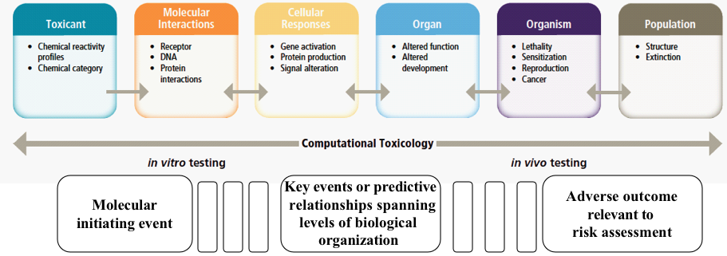
Adverse Outcome Pathways and the EDSP
ToxCast
ToxCast
Tier 1
EDSP Tier 1
EDSP Tier 2

Slide 15
AOP, Toxicity Pathway and ER Model
ER Agonism
Increased ER activation
Increased uterine wt
Increased ovarian wt
Altered gonadal histopathology
Decreased age/wt VO
Altered Development
Altered Estrous cyclicity
ER Binding
ERTA
Uterotrophic
Female Pubertal
EOGRT
Female Pubertal
EOGRT
Female Pubertal
EOGRT
EOGRT
Adverse Outcome Pathway
ER Agonism
Increased ER activation
Increased uterine wt
ER Binding
ERTA
Uterotrophic
Toxicity Pathway
ER model

Slide 16
AOP Network model:
Estrogenicity
ER Binding
ER Agonism
Altered
Steroidogenesis
(e.g. StAR, CYP11a, CYP17)
Increased E2
Increased ER activation
Increased uterine wt
Increased ovarian wt
Altered gonadal histopathology
Decreased age/wt VO
Altered Development
Altered Estrous cyclicity
Steroidogenesis
EOGRT
ERTA
Uterotrophic
Female Pubertal
EOGRT
Female Pubertal
EOGRT
Female Pubertal
EOGRT
EOGRT
Adverse Outcome Pathway
ER Binding
ER Agonism
Altered
Steroidogenesis
(e.g. StAR, CYP11a, CYP17)
Increased ER activation
Increased uterine wt
Increased ovarian wt
Altered gonadal histopathology
Decreased age/wt VO
Altered Estrous cyclicity
Steroidogenesis
ERTA
Uterotrophic
Female Pubertal
Female Pubertal
Female Pubertal
Toxicity Pathway
ST model
+
ER model

Slide 17
Evolution of EDSP Screening and Testing
EDSP Tier 1 Battery of Assays (current) | High Throughput Assays and Computational Model Tier 1 Battery Alternatives
Estrogen Receptor (ER) Binding | ER Model (alternative)
Estrogen Receptor Transactivation (ERTA) | ER Model (alternative)
Uterotrophic | ER Model (alternative)
Androgen Receptor (AR) Binding | AR Model (Future)
Hershberger | AR Model (Future)
Aromatase | STR Model (Future)
Steroidogenesis (STR) | STR Model (Future)
Female Rat Pubertal | ER, STR , THY Models (Future)
Male Rat Pubertal | AR, STR , THY Models (Future)
Fish Short Term Reproduction | ER, AR, STR Models (Future)
Amphibian Metamorphosis | THY Model (Future)
EDSP Tier 2 Tests | High Throughput Assays and Computational Model Tier 2 Battery Alternatives
Rat 2-gen/EOGRT | ER, AR, STR, THY(Future)
MEOGRT | ER, AR, STR (Future)
LAGDA | THY (Future)
Quail | ER, AR, STR, THY (Future)
ER = estrogen receptor; AR = androgen receptor; STR = steroidogenesis; THY = thyroid
Slide 17 of 18

Slide 18
Summary
EDSP “Pivot” using high throughput assays and predicative models in EDSP
Computational tools peer-reviewed by SAP and for publication
Endocrine pathway models revised and improved as more data are available (ER, AR, thyroid…)
  Bioactivity predictions for thousands of chemicals
Resources focused on chemicals more likely to have endocrine effects
  List 1 chemicals have limited estrogen androgen bioactivity
  Prioritize chemicals based on bioactivity (and exposure)
  Provides alternatives to current Tier 1 screening
Multi-century project becomes multi-year
Slide 18 of 18

